Slide 1
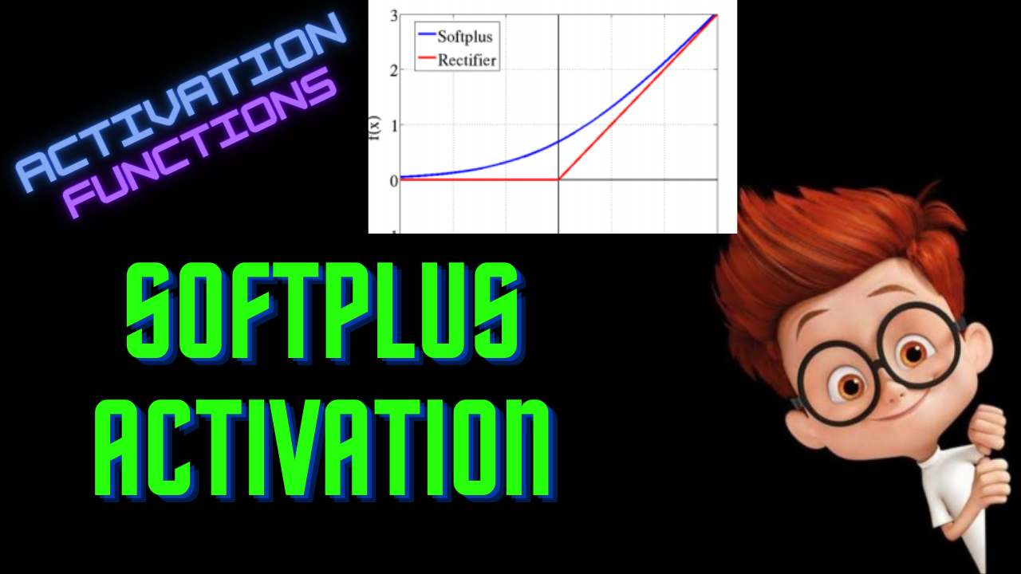

Slide 2
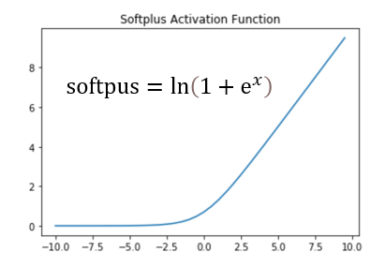
Softplus Activation

Slide 3

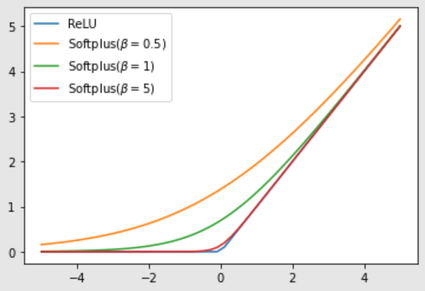
General Form

Slide 4

Derivative

Slide 5
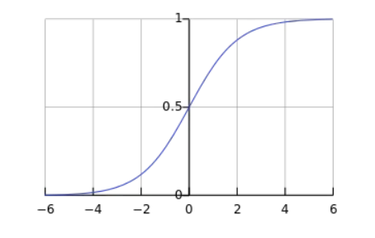
Derivative

Slide 6
Softplus
Range - (0,inf)
Smooth Gradient
No Vanishing Gradient
Computationally expensive

